Slide 1
Development of Cyber Physical Layer to defend EV Systems from Cyber Attacks: Simulation based Twining Approach
Final Checkpoint
ESE 534 Cyber Physical Systems Project
Deepi Singh
Reetam Mandal
Yash Patel
Stony Brook University

Slide 2
Introduction
Power Electronic systems are becoming more vulnerable to cyber-physical attacks.
EVs have been transforming modern transportation and energy systems.
Lack of cyber awareness in the power electronics community, it becomes more urgent to develop monitoring and diagnosis strategies for networked power electronics systems.
If these threats are not detected in the early stage, they can lead to a catastrophic failure and substantial economic loss.

Slide 3
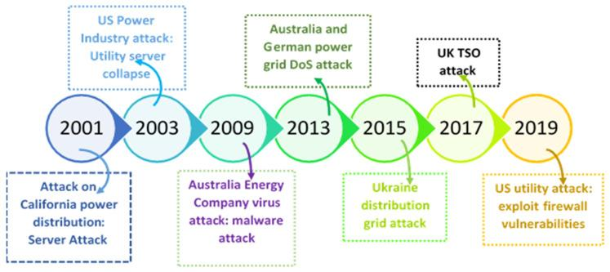
Motivation

Slide 4
Motivation
Industry 4.0 is transforming motor drives into intelligent and rapidly evolving edge devices with formidable computational power, thus enabling:
Advanced sensing, extensive data analytics, and cloud interfaces
Machine learning and AI computation
Seamless external sensor connectivity
Communication gateway capability (drives connectivity w/ cloud, sensors etc.)

Slide 5
Problem
Breach and Infringement causes systemic failure of the Electric vehicle which in turn compromises safety of the driver.
No confirmation of the signal during a breach which directly would take over the system.
Simultaneous and a slow change attack would cause systemic collapse of the model and needs to be catered to.

Slide 6
Solution
Digital Twin confirmation of every event Real time to keep ideal flow of processes in an Electric Vehicle.
Implementation of Artificial Intelligence to decipher errors and classify them as per follows:
Normal Operation
Attack 1: Noises at the sensory interface
Attack 2: Slow cyber attack
Attack 3: Change in reference values
Attack 4: Change in Controller Coefficients to stabilise the model

Slide 7
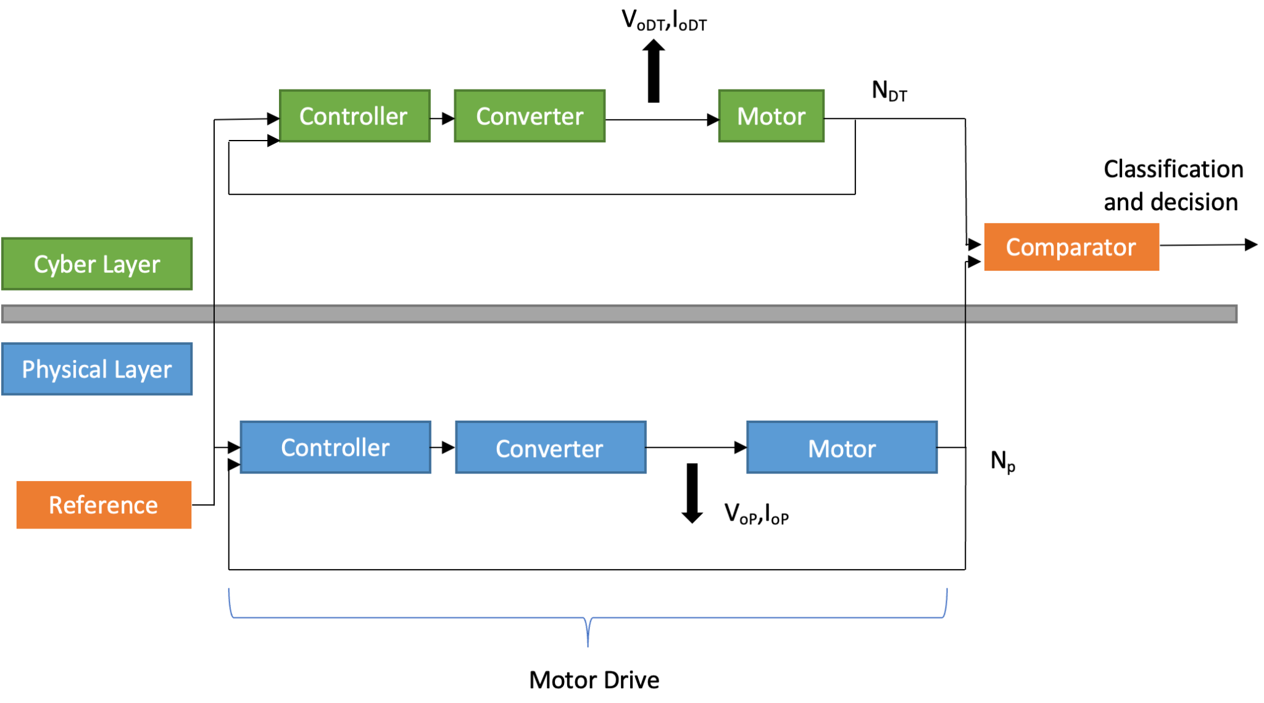
Abstract Model

Slide 8
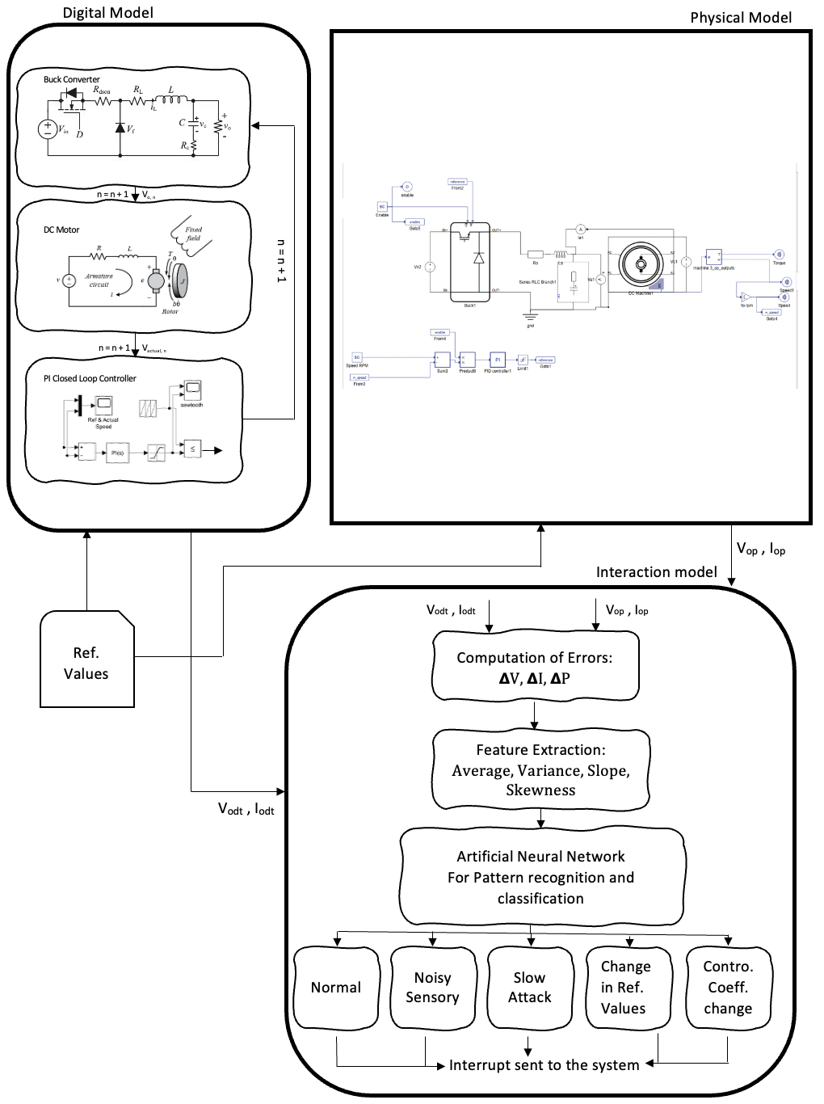
Methodology

Slide 9
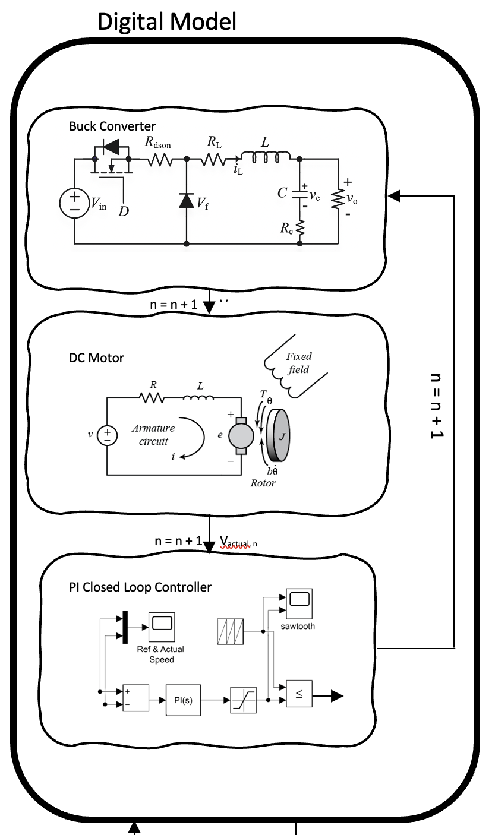
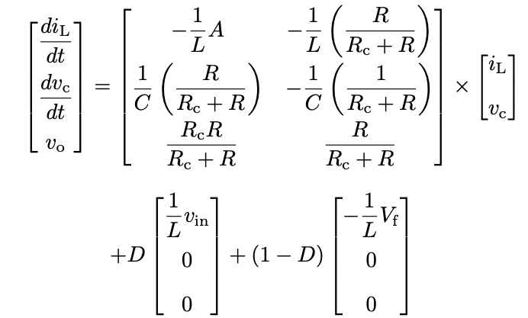
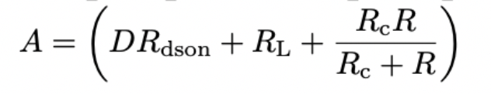
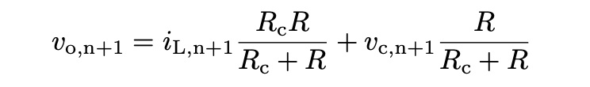
Digital Model
State Space Modelling and equations of Buck Converter
To Motor

Slide 10
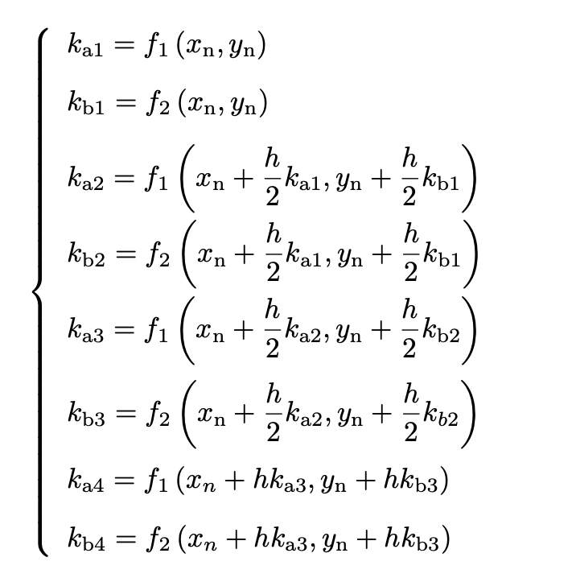
Digital Model
4th Order Runge Kutta Linearization to solve Differential Equations

Slide 11
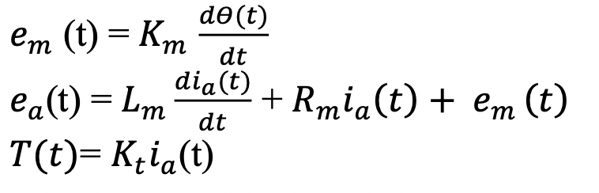
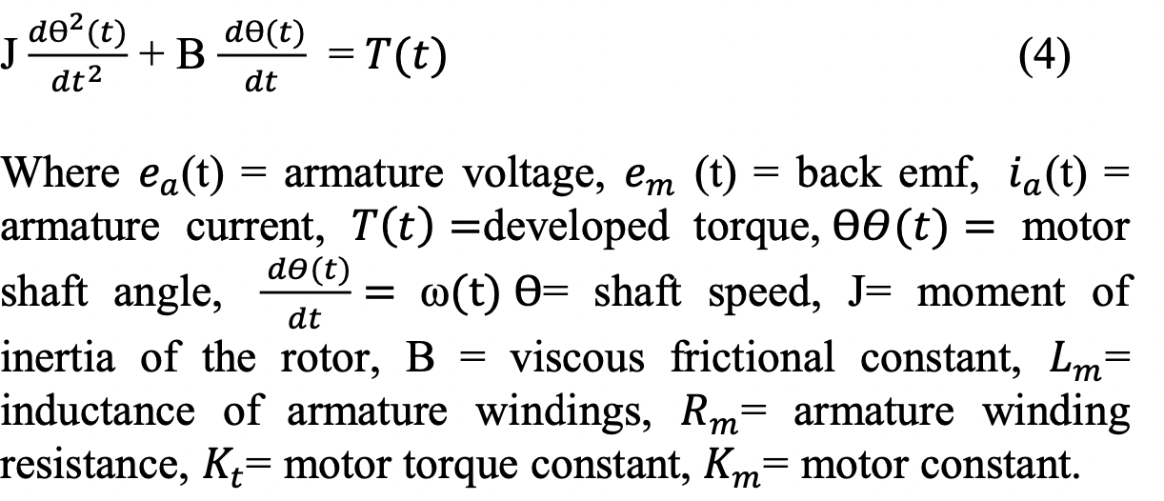
Digital Model
State Space Modelling and equations of DC Motor

Slide 12
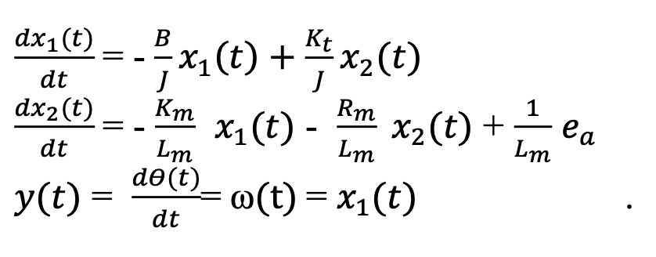
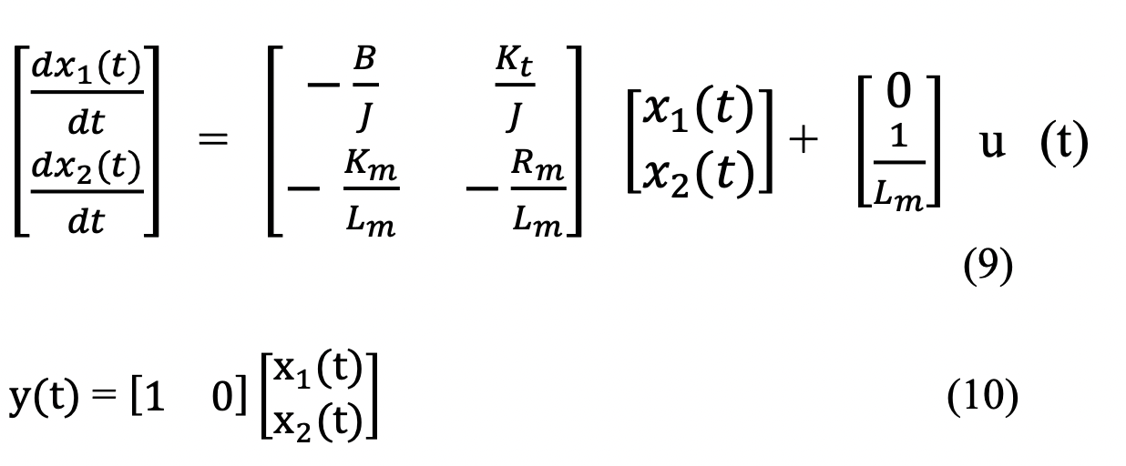
Digital Model
State Space Modelling and equations of DC Motor

Slide 13
Digital Model
State Space Modelling and equations of DC Motor

Slide 14
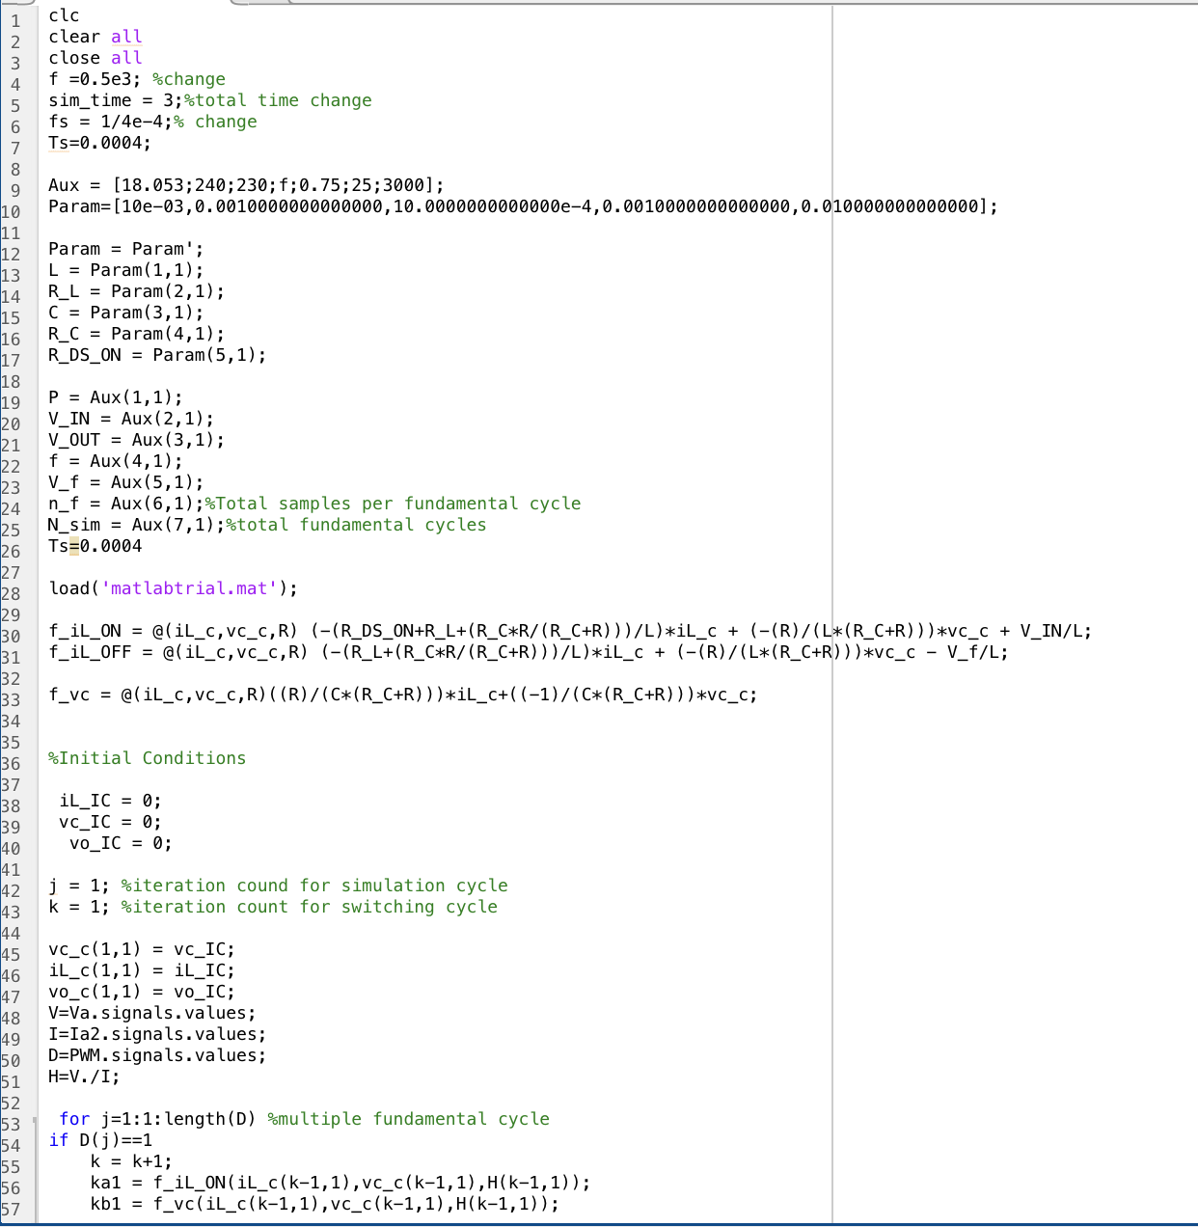
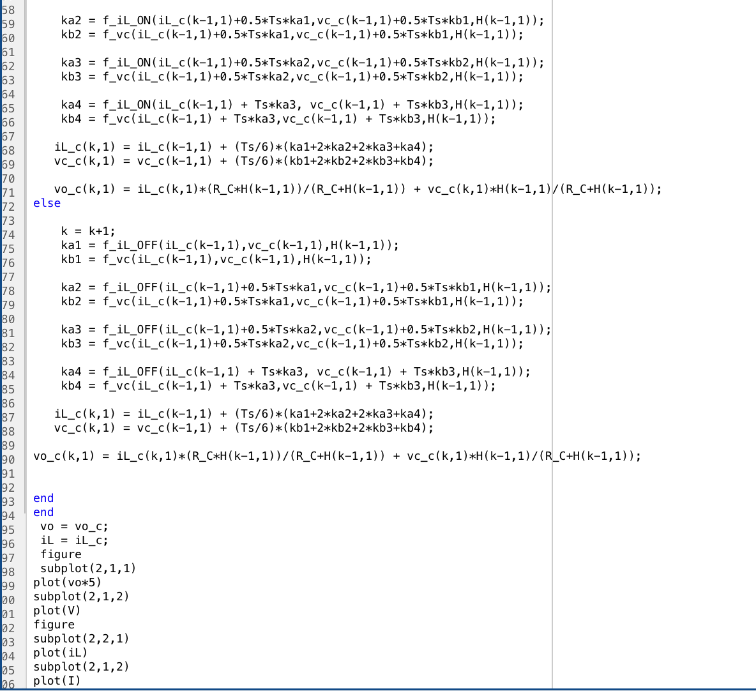
Digital Twin (Code)

Slide 15
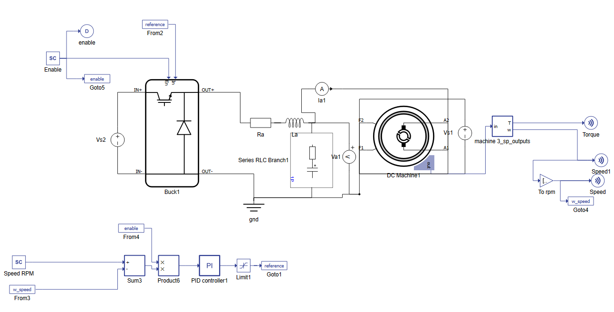
Physical Model

Slide 16
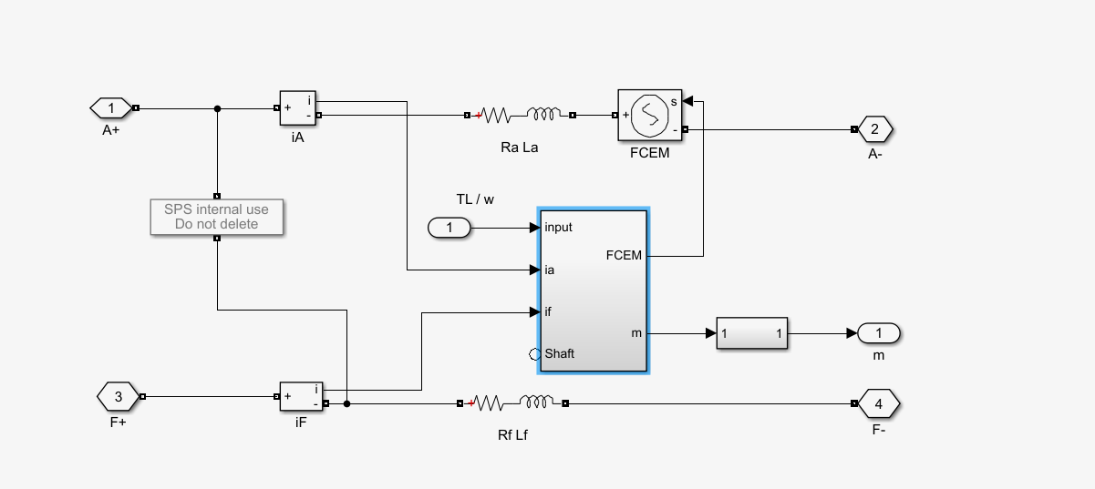
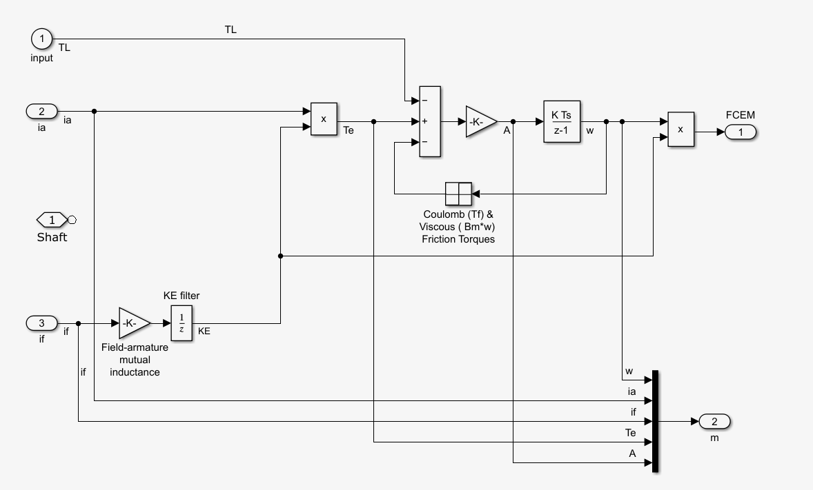
Physical Model

Slide 17
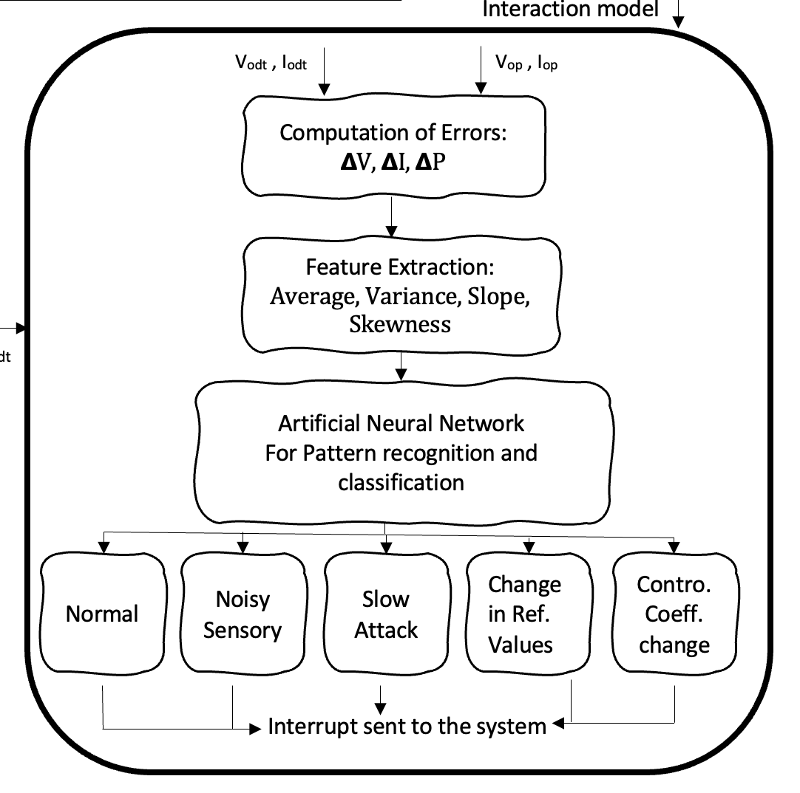
Interaction Model
Data from Digital and Physical Model Compared.
Errors further classified by extracting various features like Average, Variance and Differential.
Features fed to multiple ANN methods to assess methods for classification for every individual feature with decent accuracy
System accordingly sent an interrupt further working towards safety and security of the system.

Slide 18
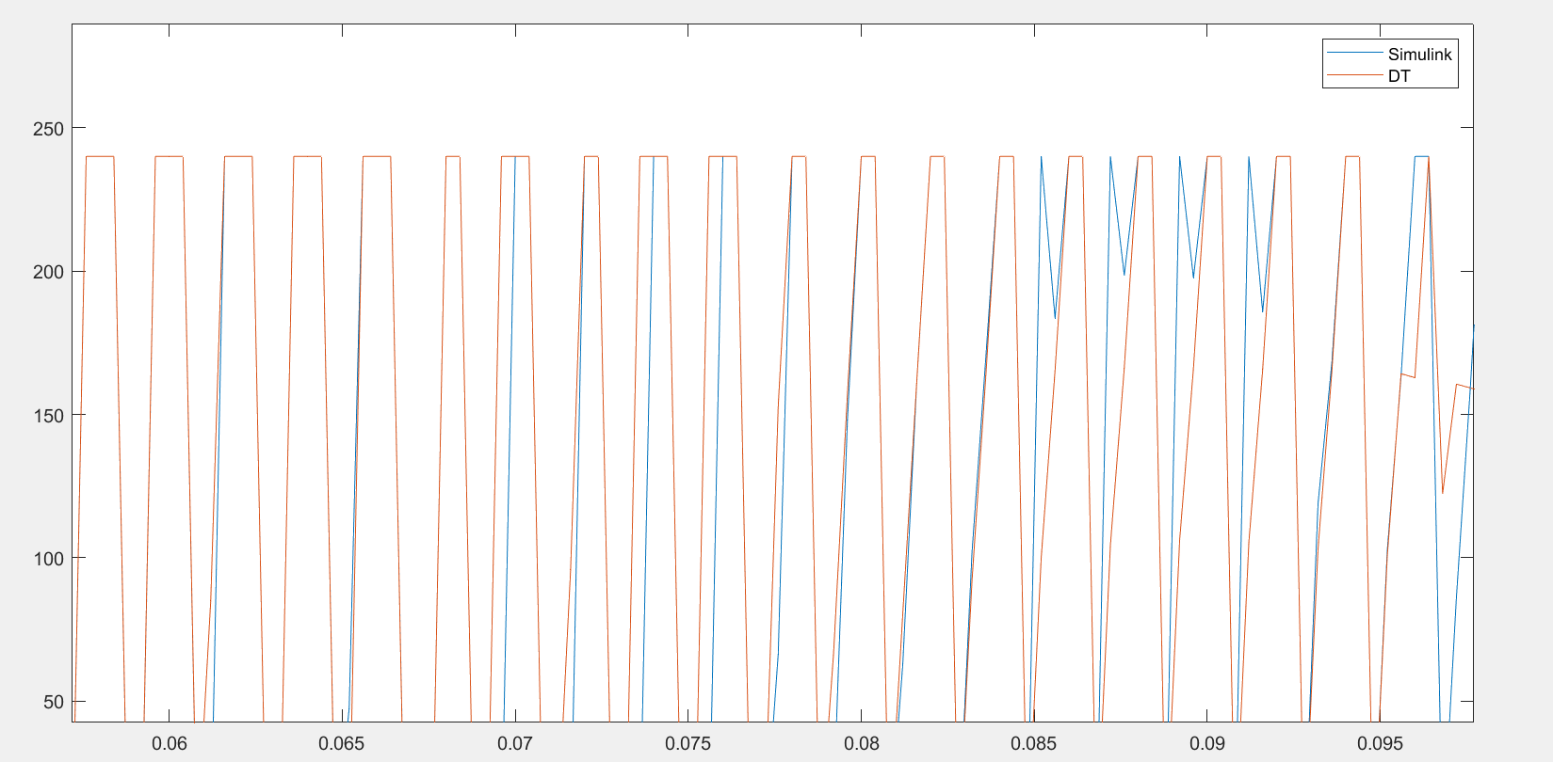
Digital Twin Validation

Slide 19
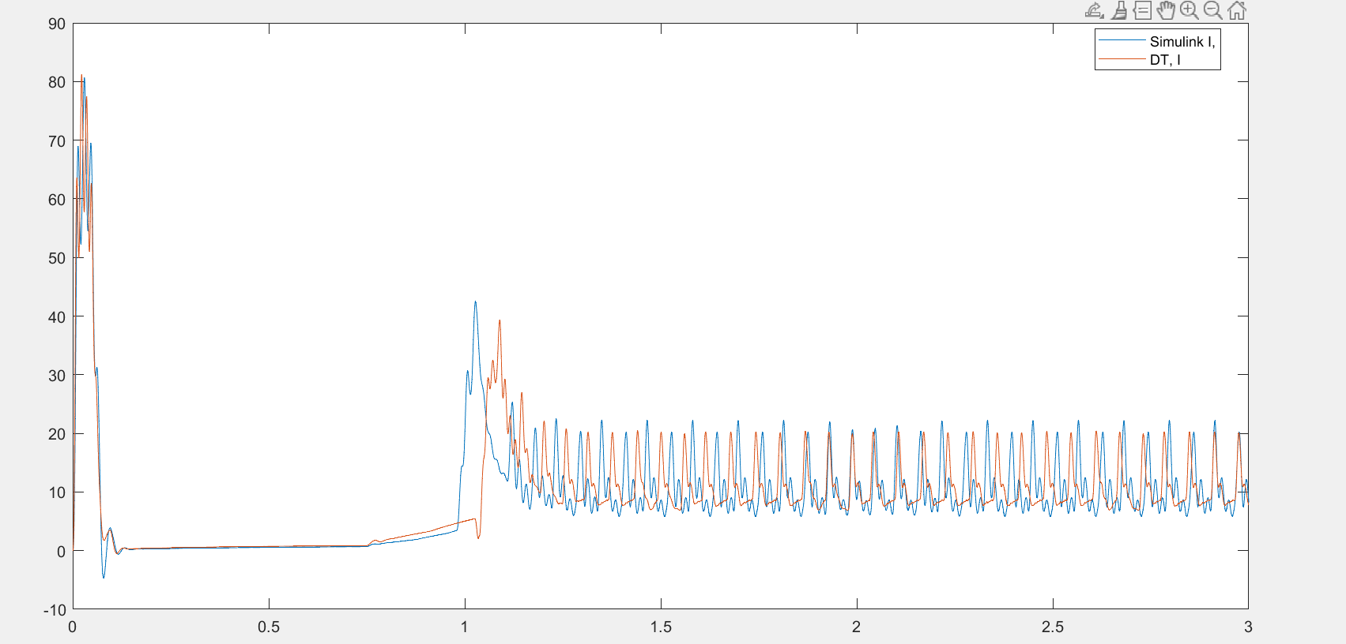
Continued…

Slide 20
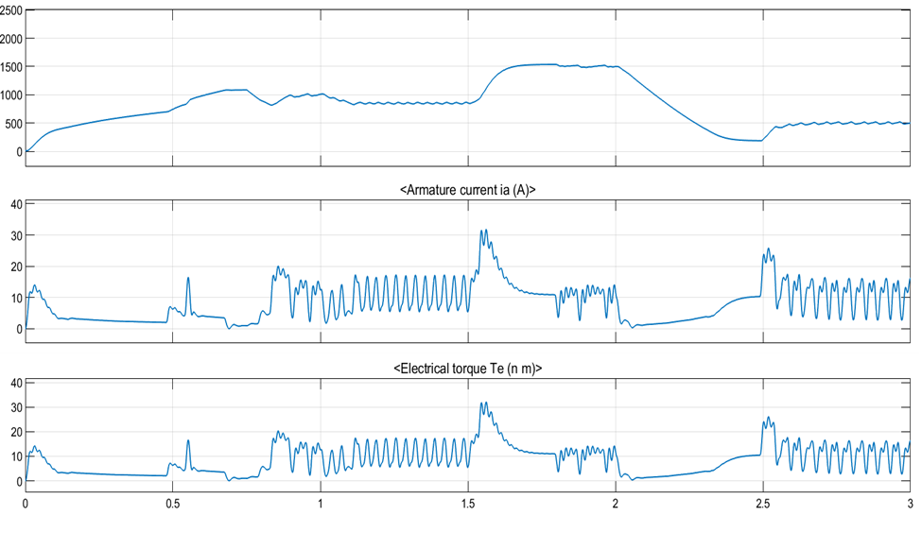
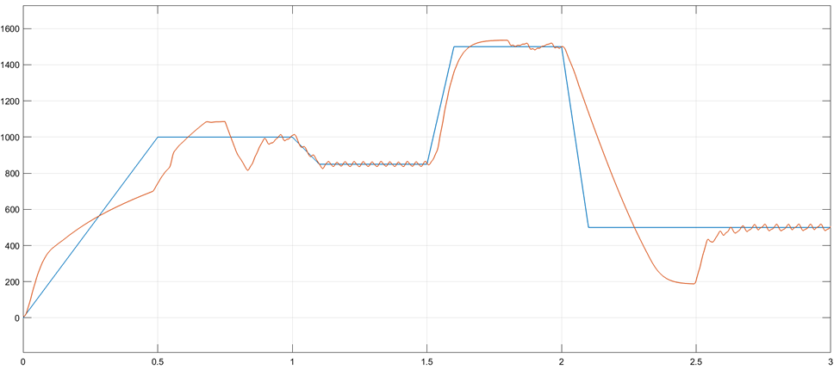
Case Study: Normal Operation
Actual vs Ref Speed

Slide 21
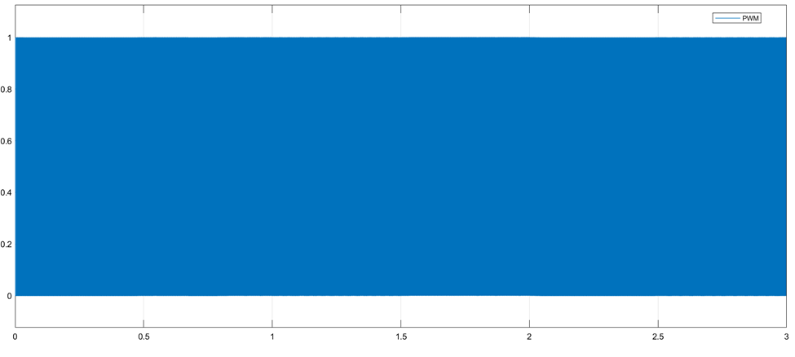
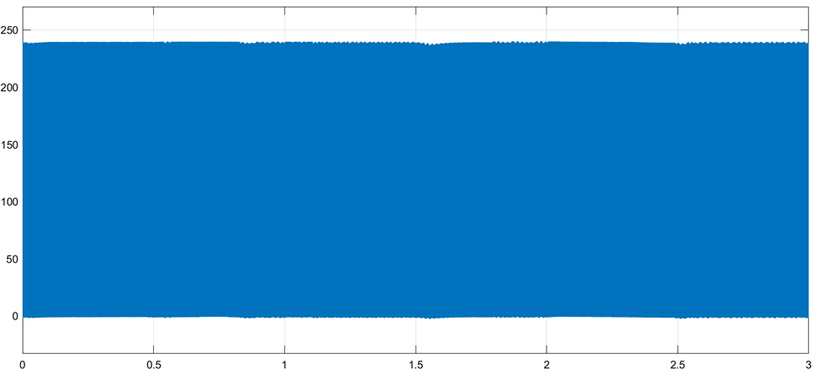
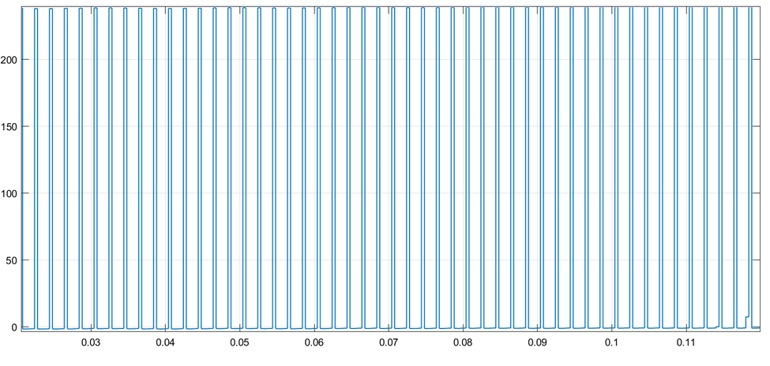
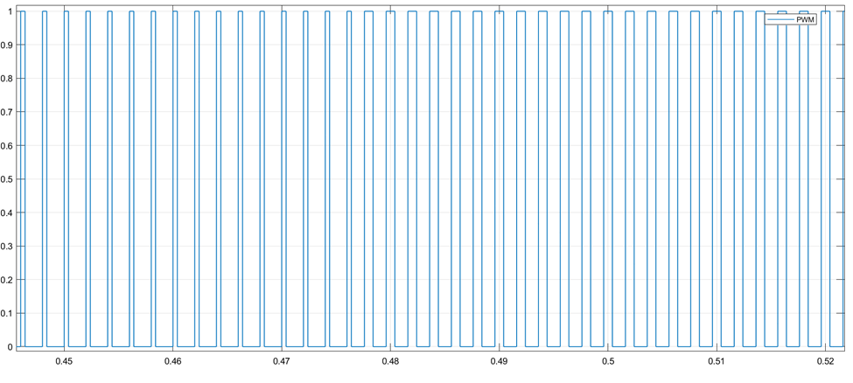
Continued….

Slide 22
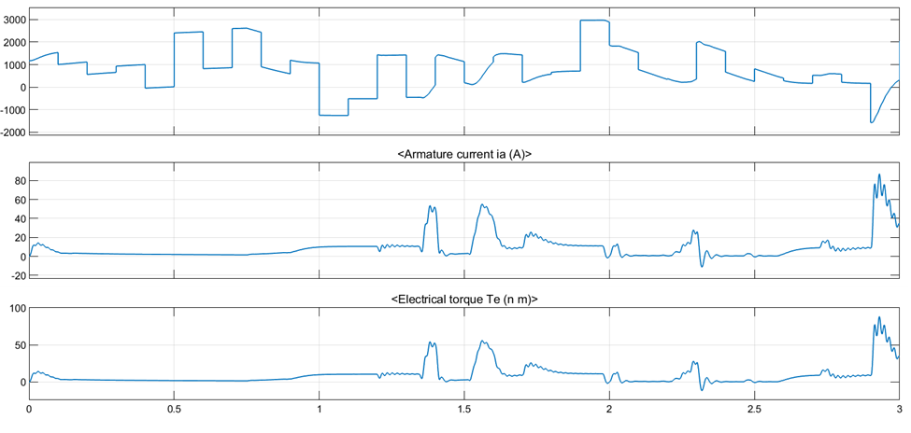
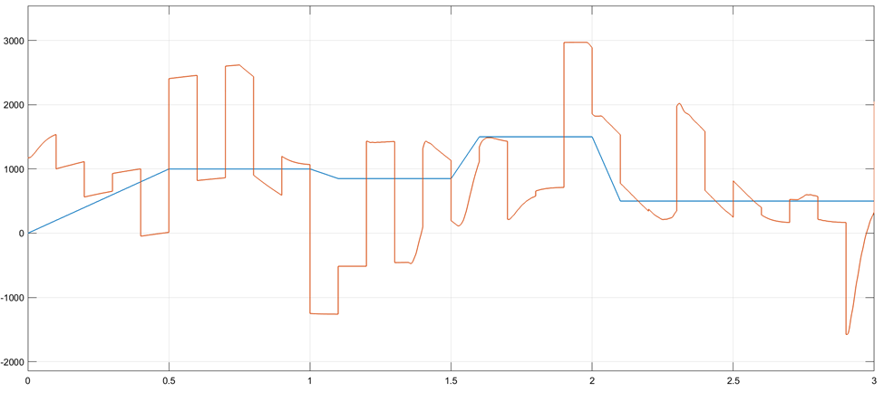
Attack on Speed Sensor

Slide 23
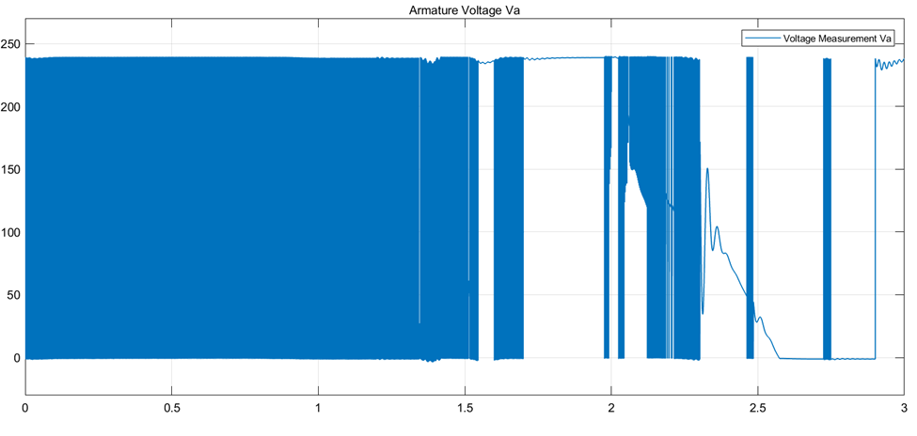
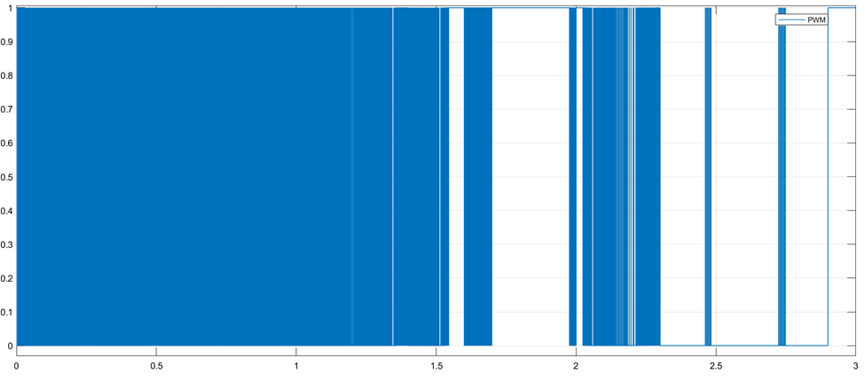
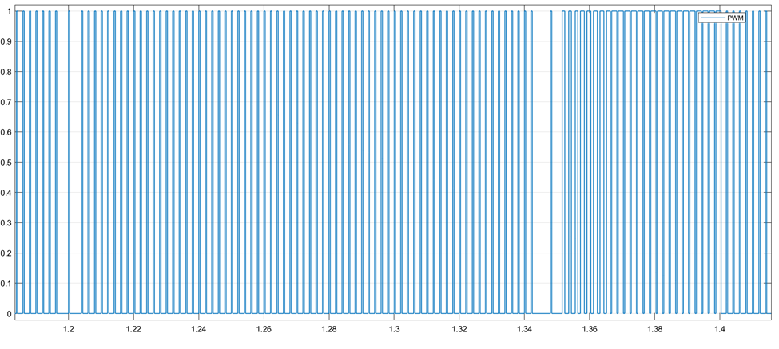
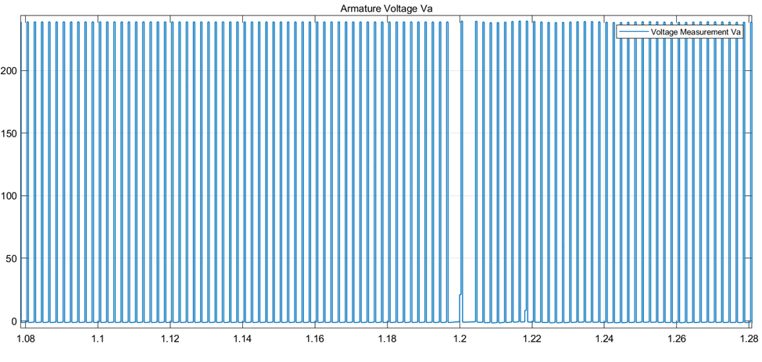
Continued…

Slide 24
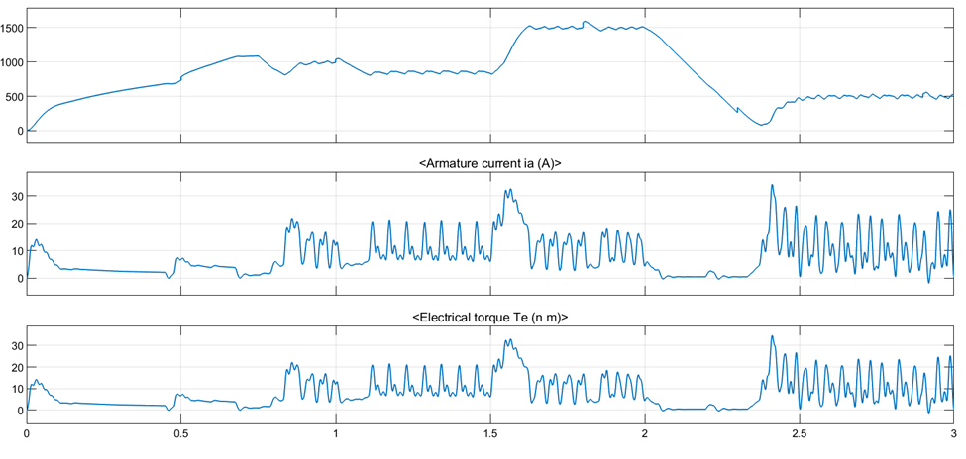
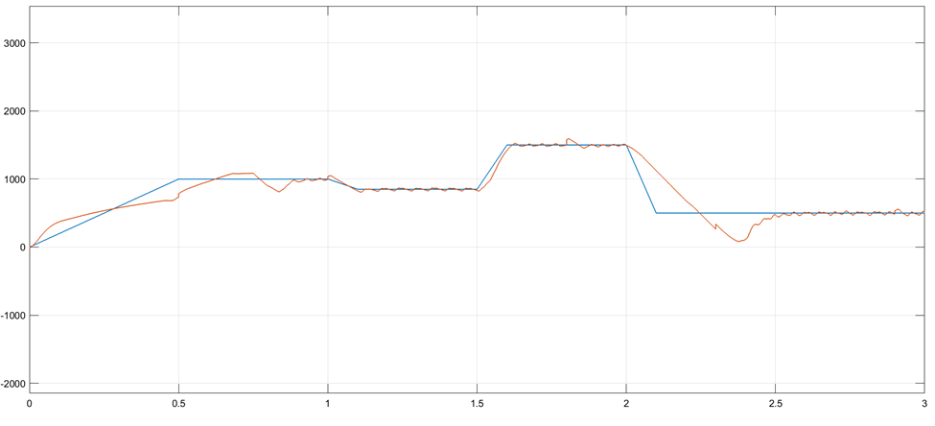
Slow Change( Staircase)

Slide 25
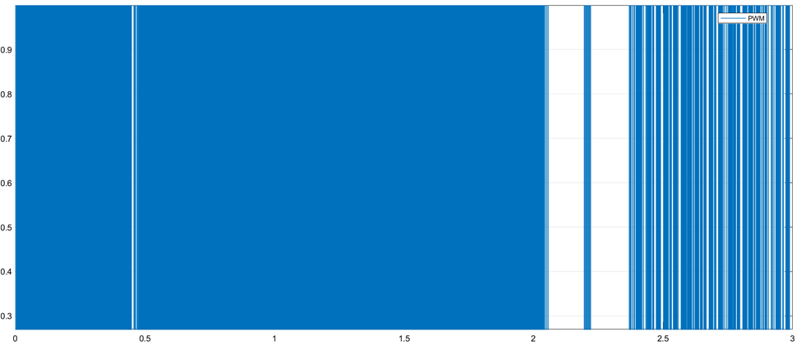
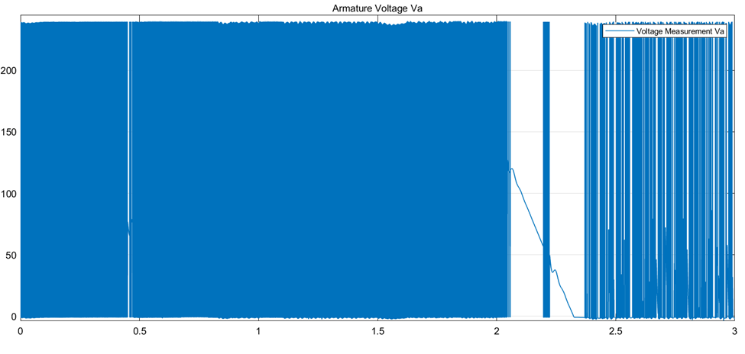
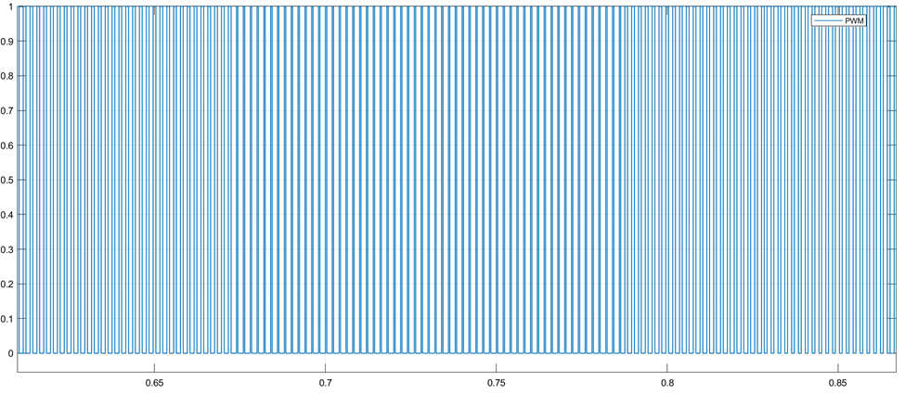
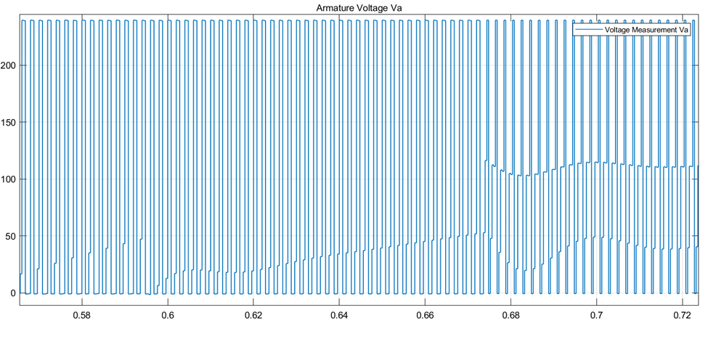
Continued…

Slide 26
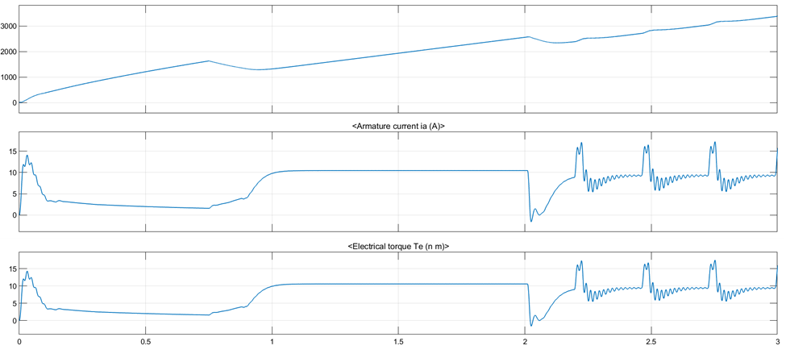
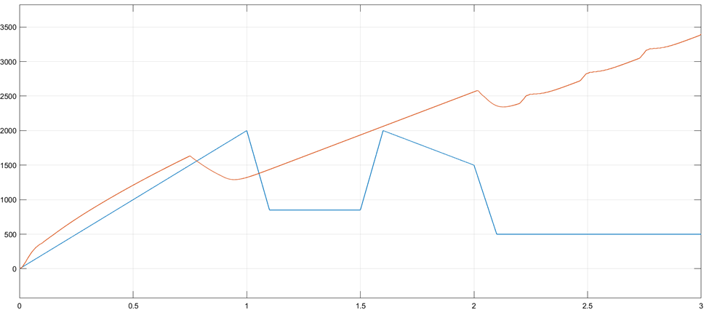
Slow Change( Ramp)

Slide 27
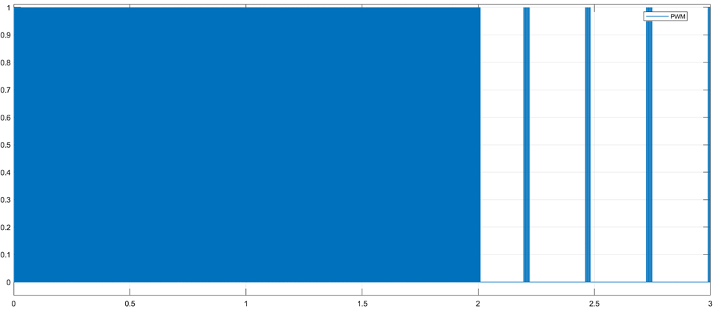
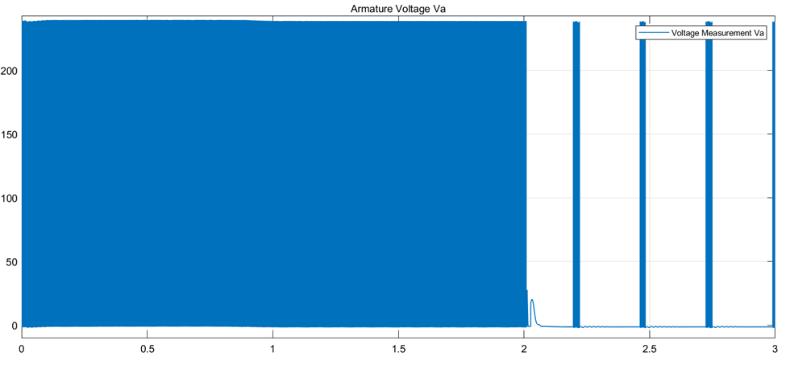
Continued..

Slide 28
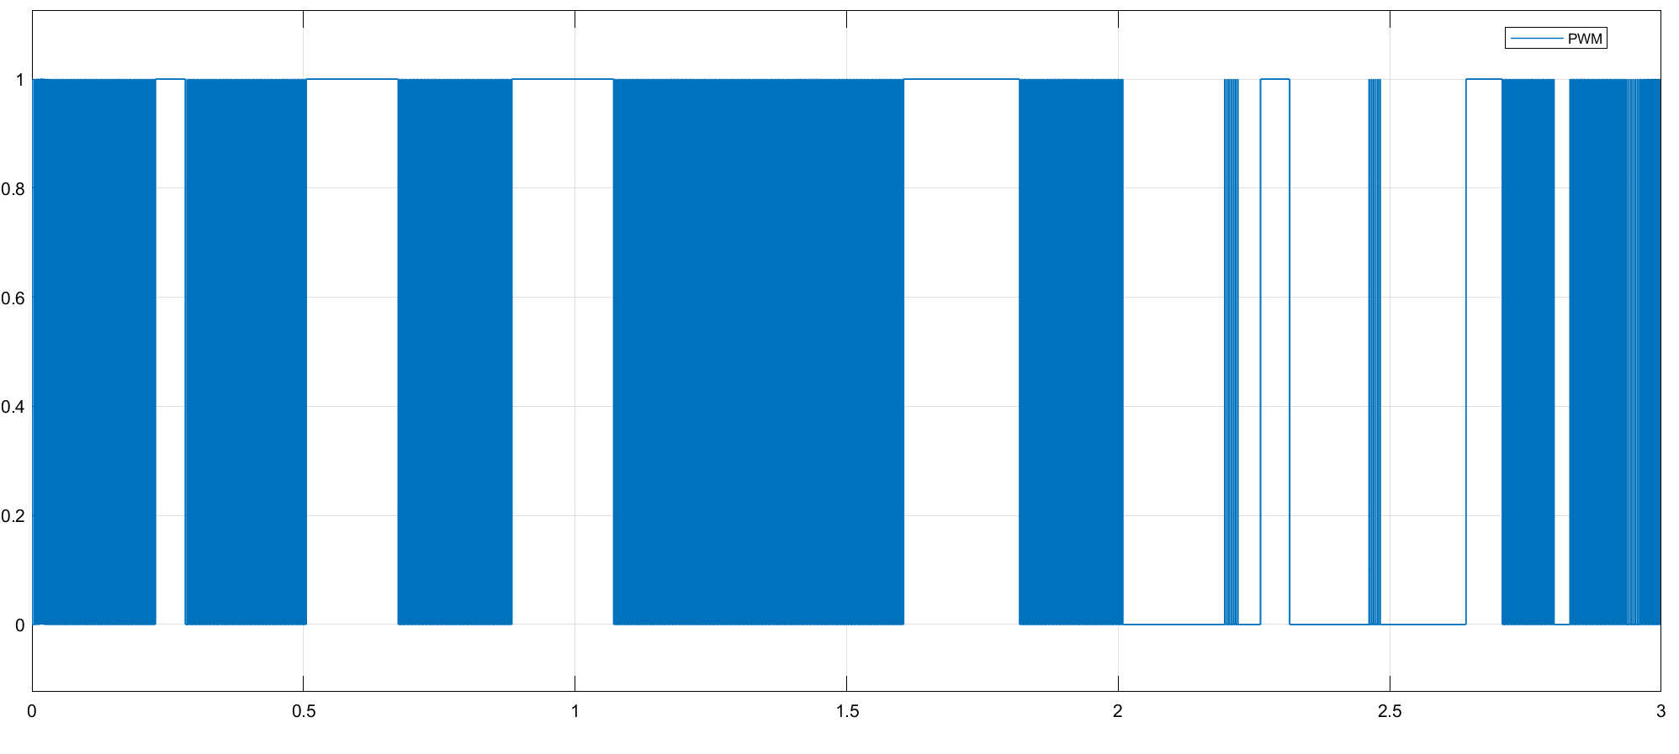
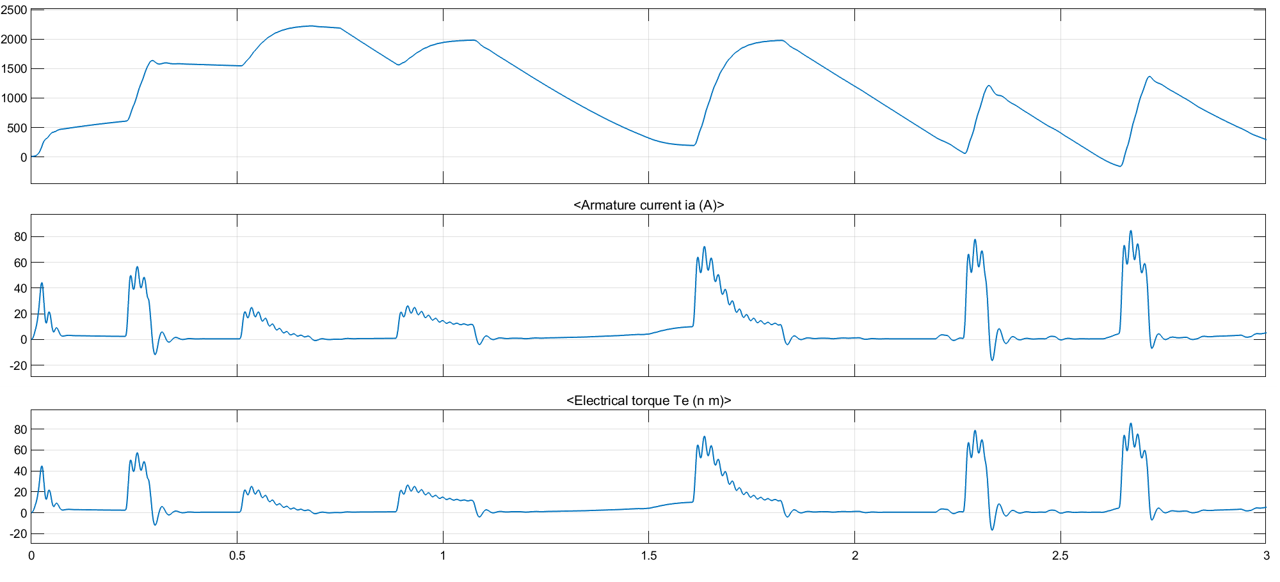
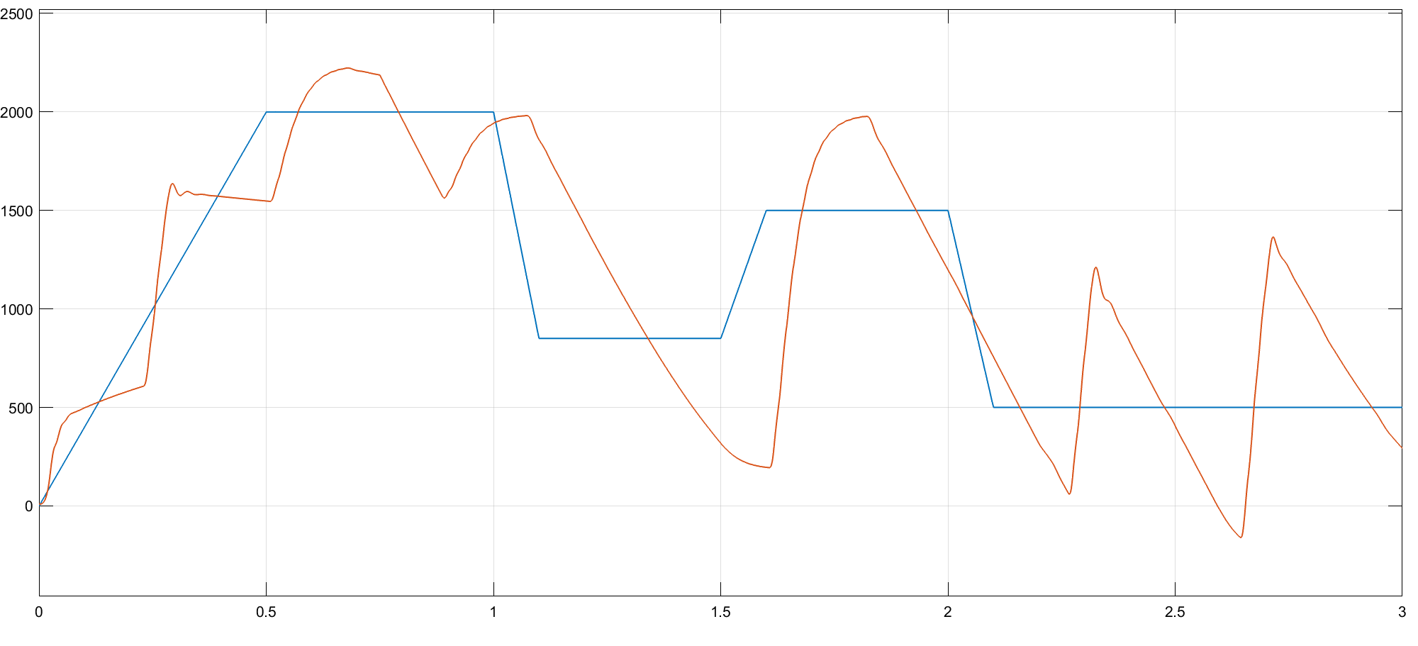
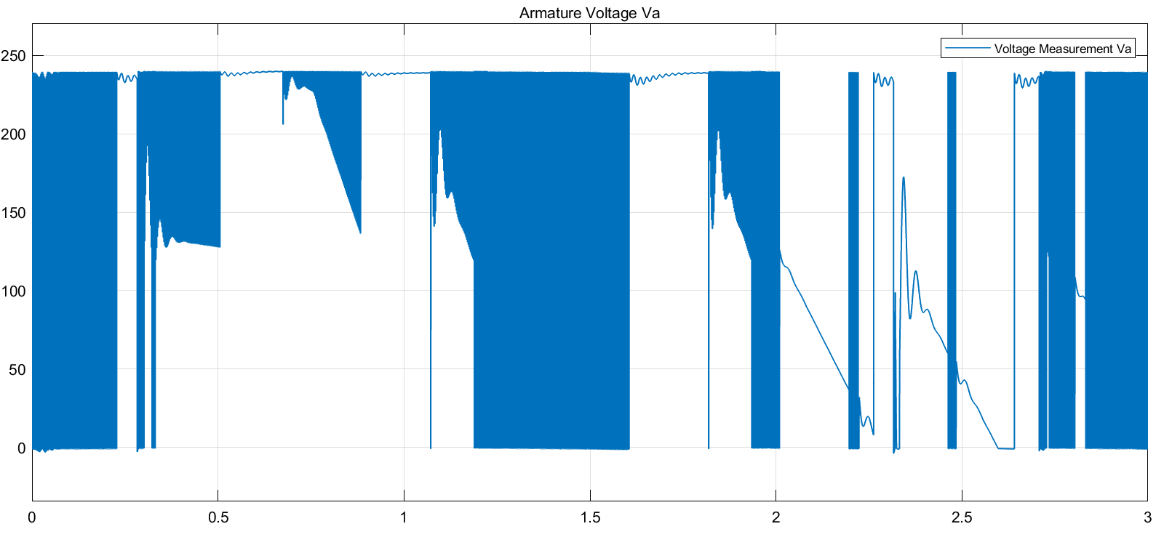
Attack on Reference

Slide 29
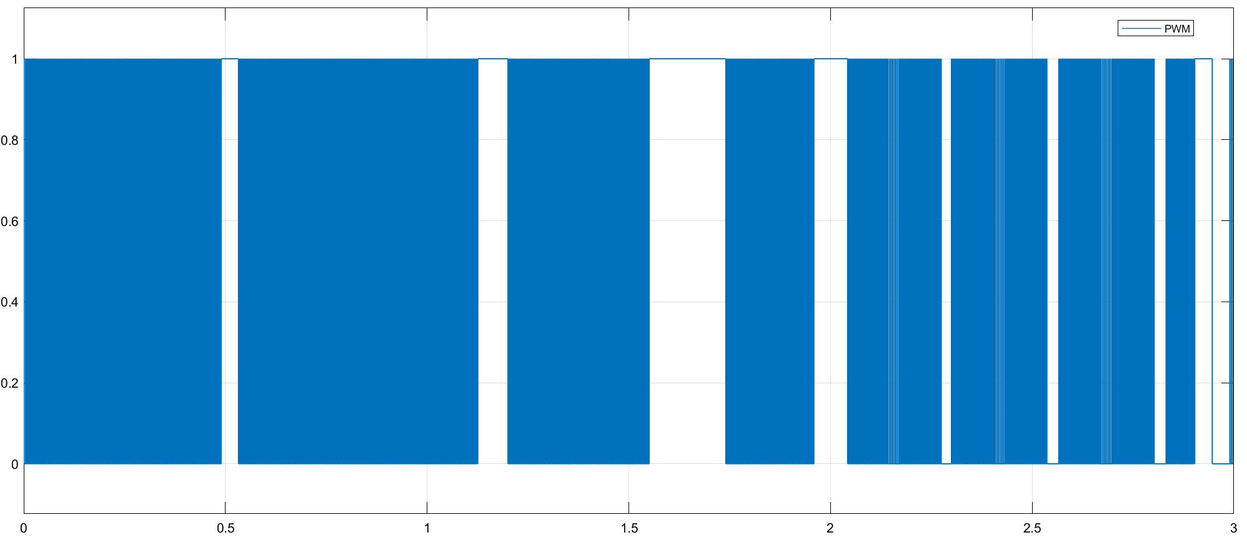
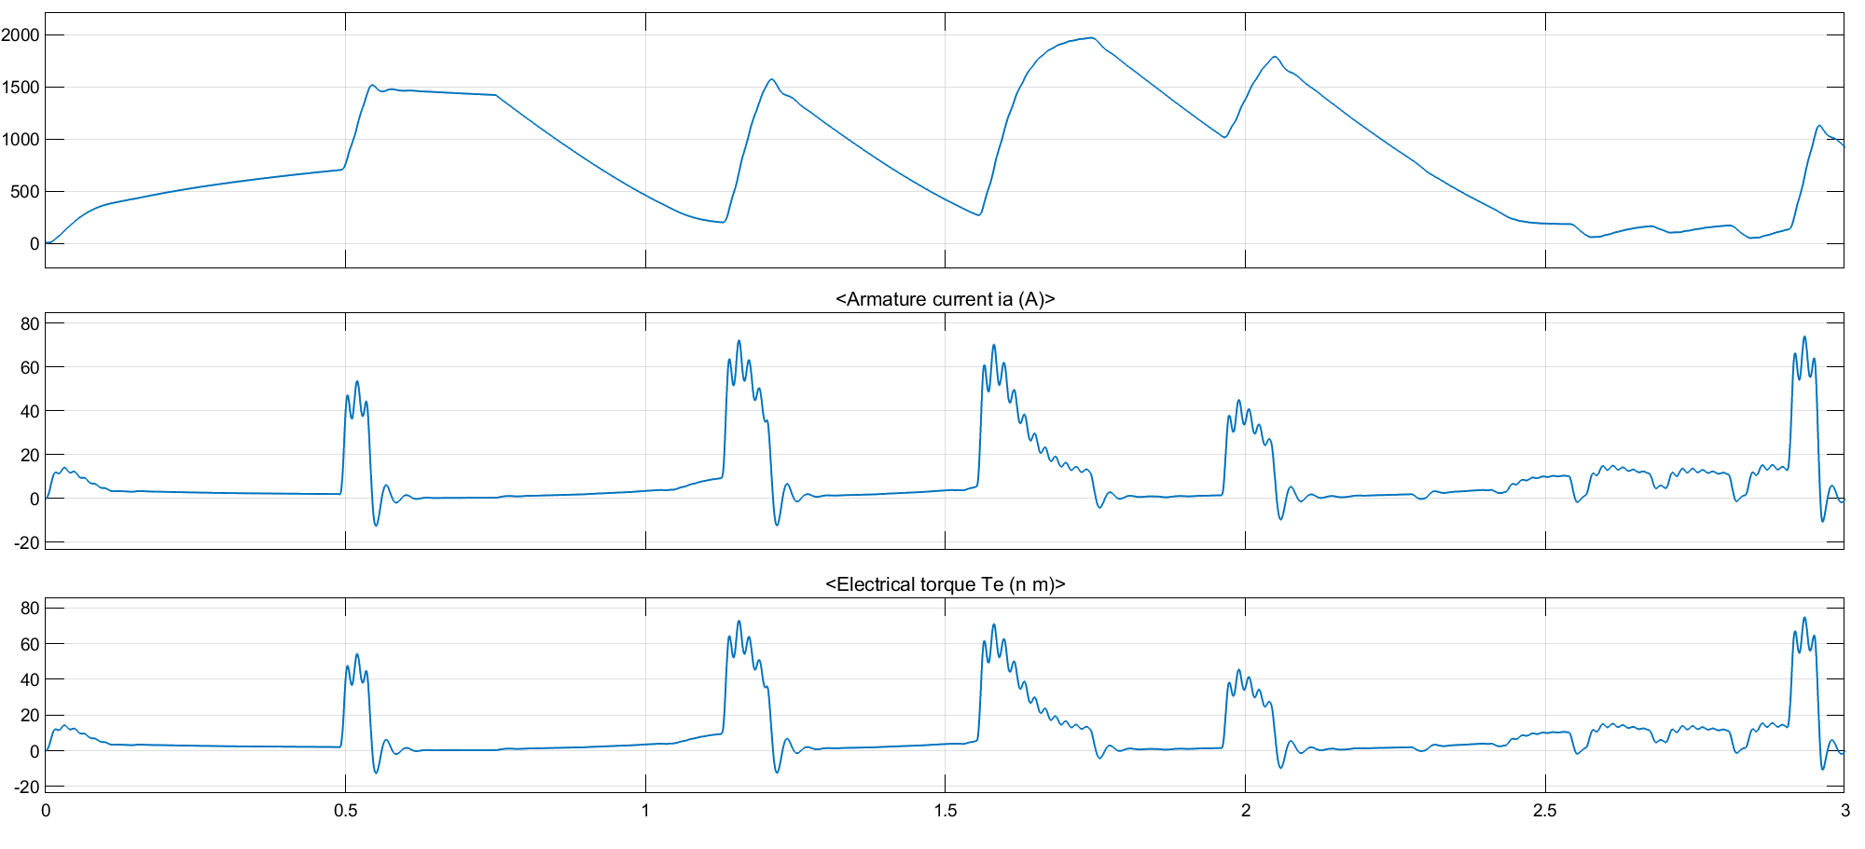
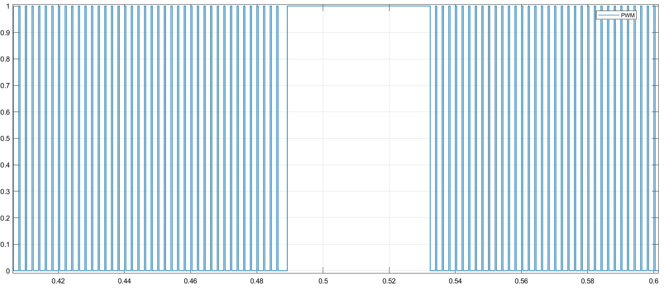
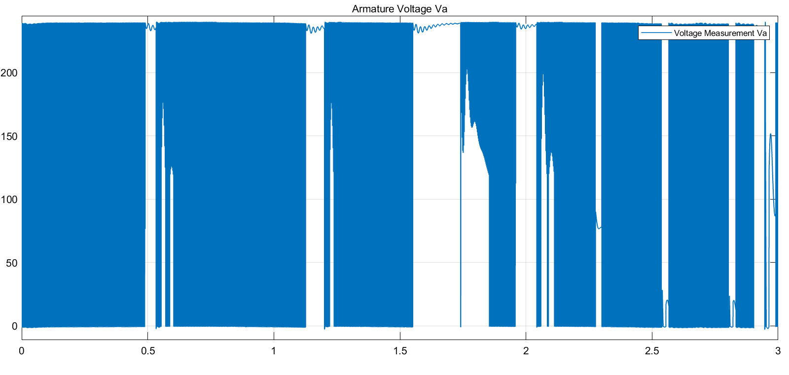


Attack on Controller

Slide 30


Multiple Attacks(Controller, Sensor & Reference)

Slide 31


Continued…

Slide 32




AI Classification:
Average Sliding Window
Slope
Notes:
FIne tree classification technique Decision Trees Many leaves to make many fine distinctions between classes (maximum number of splits is 100).
Neural network tree (NNTree) is a decision tree (DT) in which each internal node contains a neural network (NN).
Decision Trees (DTs) are a non-parametric supervised learning method used for classification and regression. The goal is to create a model that predicts the value of a target variable by learning simple decision rules inferred from the data features. A tree can be seen as a piecewise constant approximation.
SVM: Support Vector Machine : RUSBoosted Trees
Support vector machines (SVMs) are a set of supervised learning methods used for classification, regression and outliers detection. The advantages of support vector machines are: Effective in high dimensional spaces. Still effective in cases where number of dimensions is greater than the number of samples
The SVM kernel is a function that takes low dimensional input space and transforms it to a higher dimensional space
RUSBoost is an algorithm to handle class imbalance problem in data with discrete class labels. It uses a combination of RUS (random under-sampling) and the standard boosting procedure AdaBoost, to better model the minority class by removing majority class samples.
Bagging is a way to decrease the variance in the prediction by generating additional data for training from dataset using combinations with repetitions to produce multi-sets of the original data. Boosting is an iterative technique which adjusts the weight of an observation based on the last classification

Slide 33



AI Classification (Skew)
Notes:
TNN: Trilayered Neural Networks
The input values are assigned to the nodes of t he input layer. The output values are assigned to the nodes of the output layer. The hidden layer contains intermediate results of the calculation of the output values from the input values.Input layer — initial data for the neural network. Hidden layers — intermediate layer between input and output layer and place where all the computation is done. Output layer — produce the result for given inputs.
A lot of the benefit in deep neural networks comes from the ability of lower layers to learn representations that the higher layers can then use to perform their classification.
Bootstrap-aggregated (bagged) decision trees combine the results of many decision trees ... To bag regression trees instead, specify 'Method','regression' Bootstrap aggregation, or bagging, is a general-purpose procedure for reducing the variance of a statistical learning method. The algorithm constructs B regression trees using B bootstrapped training sets, and averages the resulting predictions. These trees are grown deep, and are not pruned.

Slide 34


Slope - Tree Classifier - Pseudocode
Notes:
he principal components of a collection of points in a real coordinate space are a sequence of p unit vectors, where the i-th vector is the direction of a line that best fits the data while being orthogonal to the first i-1 vector
Principal component analysis (PCA) is a technique for reducing the dimensionality of such datasets, increasing interpretability but at the same time minimizing information loss. It does so by creating new uncorrelated variables that successively maximize variance.

Slide 35
Conclusion
Development of Digital twin.
Validation using Hardware in Loop.
Case Study of different types of Second Generation attacks i.e. Hardware attacks and slow cyber attacks.
Detection and classification of attacks using Digital Twin and multiple ANN algorithms.
Comparisons of various classifications based on different features.

Slide 36
Limitations & Future Goals
The limitations of this model includes no real time infringement detection that can possible lock the digital twin out of the loop hence causing catastrophic systemic failure.
Both Digital twin and physical model uses the same Reference values so if any kind of infringement occurs at that end it would not be detected.
Future scope includes the necessary corrections for the above limitations that would increase the reliability of the system and the deployment of this model on a hardware setup.
Deployment of the Digital Twin on Amazon Web Service or Azure or other cloud platforms.

Slide 37

HIL Set-Up

Slide 38
Questions.?

